Slide 1
7BSP1361-0905-2021 - Data Analytics
Supervised Learning
Presented by 20068785

Slide 2

OBJECTIVE
The main Objective is to use the Credit data that is provided to carry out a Statistical analysis and predict if it's a good idea to give a loan to potential borrowers in the dataset.

Slide 3
For this Analysis, we will Utilize the four major techniques of supervised learning which include;
Decision Tree
Logistic Regression
Discriminant Analysis
K-Nearest Neighbours
All these techniques will be carried out using R Studio and the Data set Provided is CREDIT 14.
METHODOLOGY

Slide 4

DECISION TREE
Decision tree is one of the Supervised learning technique which is used to model and predicts the value of a target variable by using some or all other dataset features.
This method shows a visual output of the process and values for all the decision made from the data set to predict the target variable.

Slide 5
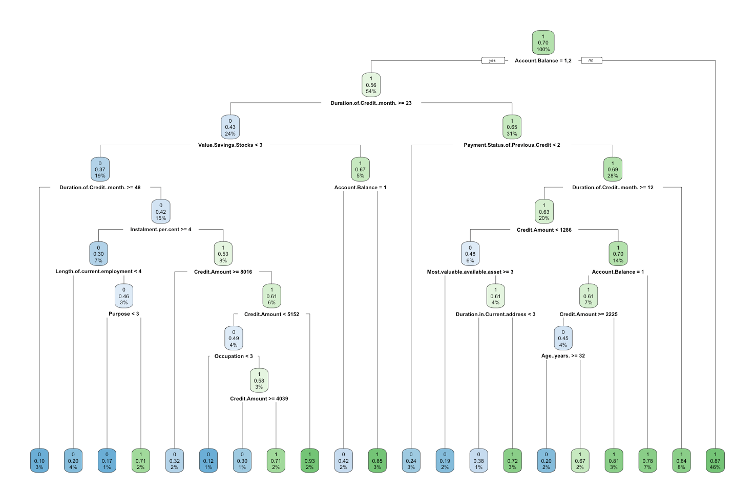
DECISION TREE FOR CREDIT14
Decision Tree

Slide 6
What does it tell us?
The decision tree consists of the variables used to predict the target variable; Creditability. Each node represents a decision point before arriving at a leaf node.
The most important variable used to determine the creditability of each customer is the Account Balance (root node), such that customers with Account balances that were not in categories 1 and 2 were classified as bad loans, while those that were in categories 1 and 2 were classified to be bad loans but subjected to further checks through the internal nodes such as Duration of credit months.
At the internal node, i.e Duration of credit month, Customers in categories 1 and 2 whose duration of credit month is more than 23 months and those greater than 47 months is classified as good loan while those below this are classified as bad loans.

Slide 7
The probability of rejecting a customer with account balance in category 3 and 4 is 46% while the probability of being subjected to check of duration of credit month is 54% if the account balance falls with the level 1 and 2 categories. Similarly for other nodes
What does it tell us?

Slide 8

LOGISTIC REGRESSION
The second technique is the Logistic regression.
This model is a classification algorithm technique which uses probability to determine the relationship between the categorical dependent variable and one or more independent variables.
The Variable chosen for this analysis are;
(I)Creditability
(II)Duration of credit month
(III)Credit Amount
(IV)Account balance

Slide 9
The technique starts with an understanding of the categorical variable chosen. In the case of Credit 14, a table of possible outcomes is predicted as thus;
Creditability | Account Balance
 | Level 1 | Level 2 | Level 3 | Level 4
good loans (0) | 124 | 93 | 13 | 41
Bad loans (1) | 121 | 152 | 45 | 311
The table above shows the outcome of different level of account balance and the corresponding decision based on their creditability.
124, 93, 13 and 41 customers are predicted as good loans for each rank of account balance Level 1,2,3 and 4 respectively, while 121,152,45 and 311 customers are predicted as bad loan for each rank of account balance level 1,2,3 and 4 respectively.
LOGISTICS REGRESSION

Slide 10
Coefficients | Estimate
Intercept | 0.7792
Duration of credit month | -0.0328
Credit Amount | 0.000034
Account balance 2 | 0.6027
Account balance 3 | 1.098
Account balance 4 | 2.083
LOGISITIC REGRESSION COEFFICIENTS

Slide 11
The Logistics coefficient and the estimates above indicates that;
If all other Independent variable remains constant, the log odds of creditability is given by 0.7792
For every one unit increase in the duration of month , the log odds of Creditability changes by –0.0328
For every one unit increase in the Credit Amount, the log odds of Creditability increases by 0.000034
However, a customer who have an account balance level 2,3 or 4 compared to Level 1 changes the log odds of admission by 0.6027, 1.098 or 2.083 respectively.
What does it tell us?

Slide 12
The Wald test which was carried out to test the significance of account balance levels in the model have a p-value less than 0.05. This means that the overall effect of account balance in the model is statistically significant
LOGISTICS REGRESSION

Slide 13
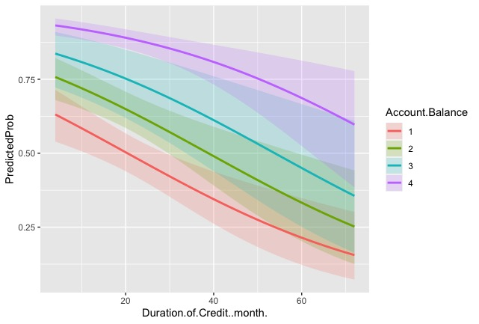
The graph shows the Predicted probability of Creditability
In general, for each level of Account balance and Duration of Credit month, the predicted probability shows the likely of getting a loan or not. For instance, a customer with Account level 1 and duration of credit month above 40 have a higher chance of being considered a good loan while account balance level 4 and duration of credit month below 20 have a higher chance of being predicted as a bad loan

Slide 14
TEST OF THE OVERALL MODEL
The chi-square of 157.6755 with 5 degrees of freedom and an associated p-value of less than 0.001 indicates that the model fits significantly better than a null model.

Slide 15
DISCRIMINANT
ANALYSIS
This is the third technique which will be used to analyse our data set.
Discriminant analysis is statistical technique used to classify observations into non-overlapping groups, based on scores on one or more quantitative predictor variables.
The predictor selected for this analysis are,
Duration of credit months
Credit Amount
Installment percent
Duration in current address
Age
Number of credits at the bank
Number of dependents

Slide 16
Group | Creditability
Predictor | Good loans (0) | Bad Loans (1)
Duration of Credit month | 24.808 | 19.095
Credit Amount | 3998.83 | 2980.207
Installment percent | 3.074 | 2.8998
Duration in Current Address | 2.831 | 2.836
Age(years) | 34.041 | 36.035
No of Credits in the Bank | 1.362 | 1.431
No of Dependents | 1.155 | 1.164
What does it tell us?
The table above shows the group means of the predictors that will be used in predicting the creditability if each group were given equal probabilities.

Slide 17
This indicates that, for a predictor like Duration of month, the group means average predicted to be a good loan is 24.8 months, while the group means average predicted to be a bad loan is 19.05 months.
The group means average predicted credit amount to be a good loan is 3998.83, while the group means predicted to be a bad loan is 2980.207, similarly to others .
What does it tell us?

Slide 18
From the table above, 145 observations from the data set are predicted to be good loan while 413 observations are predicted to be bad loans.
216 observation and 126 observation are not predicted correctly.
Overall, 558 observations are predicted correctly which sums up to about 62% of the data set.
Predicted Creditability | Good Loan (0) | Bad Loan (1) | sum
Good Loan (0) | 145 | 126 | 271
Bad Loan (1) | 216 | 413 | 629
sum | 361 | 539 | 900
SUMMMARY OF THE DISCRIMINANT CAPABILITIES

Slide 19
Misclassified Creditability
32% of Creditability observations in the data set is found to be misclassified.
SUMMMARY OF THE DISCRIMINANT CAPABILITIES

Slide 20
K-NEAREST NEIGHBOURS
This is the fourth and final technique that will be used to analyze the credit 14 dataset.
KNN method is a supervised or unsupervised learning method which is used in classification and regression of predictive models. It utilizes a predefine training sample to identify new data point that are closest to it in distance and put label on these samples.

Slide 21
DATA PREPARATION
For this purpose of this technique, the following variable will be used for the analysis;
Creditability(Dependent Variable)
Duration of Credit month
Credit amount
Duration in Current Address
Age in years
Number of existing Credit in the bank
No of Dependent

Slide 22
All the selected non-categorical variable selected were used to predict the creditability of the loan.
90% of the dataset was used as the training data to test the 10% test target for its accuracy of prediction
EVALUATION
 | Test target
Prediction | Good Loan(0) | Bad Loan(10
Good Loan (0) | 2 | 4
Bad Loan (1) | 17 | 67
The table above shows the prediction outcome for the test target to be good or bad loan such that all the observations in the diagonal (i.e., 2 and 67 are predicted correctly and the others are not predicted correctly.
The Prediction outcome table has an accuracy of 76.67% which is good.

Slide 23
The four techniques of supervised learning have been used to explore the data set given (CREDIT 14). Using the decision tree is one of the best ways to visualize and predict the loan creditability of every bank customer, and it is very easy to interpret. Based on the decision tree output, the Logistics regression model was used to explore some of the variables.
To estimate loan creditability, regression coefficient estimates were used to understand how each variable changed. With a p-value less than 0.05, the Logistics model has a statistically significant predictive probability of creditability based on the different levels of Account balance and the duration of credit months.
Conclusion

Slide 24
Some of the independent variables in the given data set were used as predictors to predict the dependent variable in discriminant analysis based on the mean of their overlapping groups. The technique correctly predicted 62% of the creditability observations, while 38% were misclassified.
KNN utilized a 90% predefine training sample to identify 21 new data point that are closest to it in distance and put label on these samples to a 76.67% accuracy.
Conclusion

